Slide 1
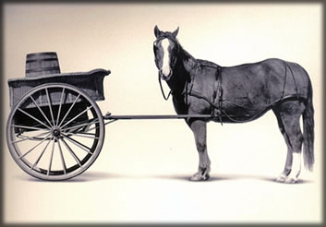
Introducing the Cart to the Horse or How We Rebuilt a Program With a Little Help From Our Friends!
Session SAS-26014
Speakers:
Kevin Baker – Westfield Group Information Security Leader
CRōb – Westfield Group Information Security Architect
Westfield Group
IBM Interconnect 2015 Conference
Owner: Information Security Custodian: CRob
Origination Date: 1/5/2015 Revision date: 2/9/2015
Document Classification: Westfield Public © Copyright 2015
Notes:
<number>

Slide 2

HI Everyone!
Notes:
<number>

Slide 3

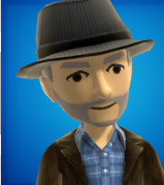
CRob
Kevin
(not CRob)
Who are These guys?
Notes:
Both up….Story in three parts
<number>

Slide 4

A story in 3 parts

Slide 5
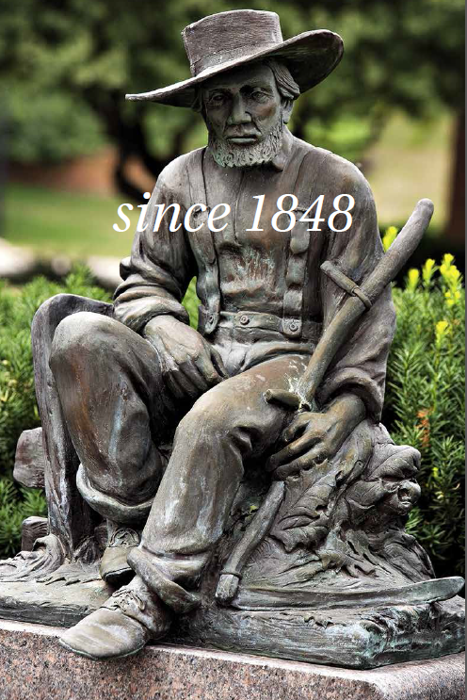
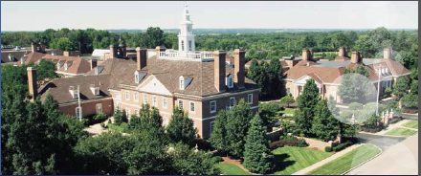
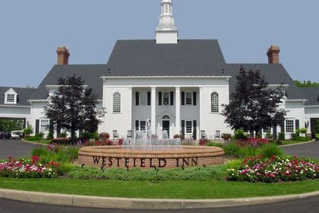

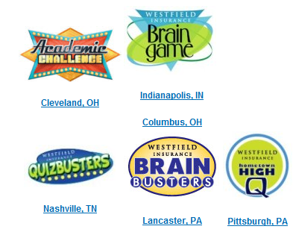

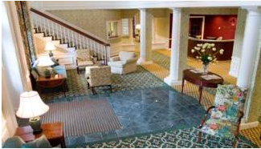
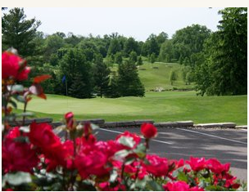
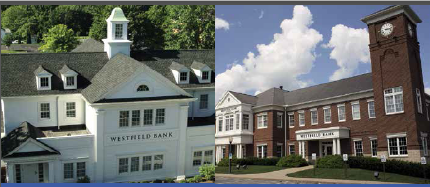

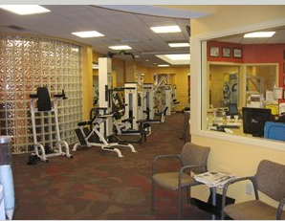


Welcome to Westfield Group.
About the golf Course company
Notes:
Kevin starts, Chris chimes in……So our goal here is to establish WF’s long and proud culture, but not necessarily focused on infosec.
It might be humorous for kevin to start out describing the golf course, and the hotel and all the “non-business businesses” then crr interjects …but kevin, we also sell insurance” kb continues….cr interjects “…and we also own a chain of banks”
<number>

Slide 6

A word about our corporate culture
Notes:
Kevin…..Just to understand the parameters we’ve been given…..call out our tag line…ask the audience “how easy do you think it would be to change a culture who so highly prides itself on transparency and sharing? Believe you me it wasn’t easy but certainly has been worth it!”
<number>

Slide 7

So, Yeah, …Carts and Horses…
Notes:
<number>

Slide 8

So the Journey begins
Notes:
Kevins initial assessment……The organization has been around far longer than the problems we now face. Introducing the idea that perhaps things were not as they should be in some areas.
<number>

Slide 9

…5 Guys and no certs
Notes:
State of the org & the program – characterize the team as task oriented, not strategists – tribal knowledge & heroic efforts – policy (perfect in the way of good)
Security governance organiational security codependant nature
<number>

Slide 10
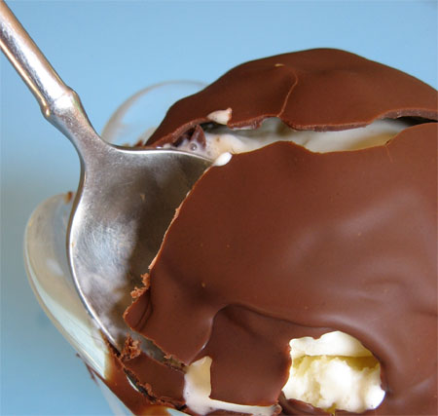

How we were geared
Notes:
Kevin & Chris…. Security philosophy --speak to the Magic Shell philosophy where our controls were focused – How many have this security philosphy today? How did this impression get started? Well you used only need a firewall to produce a hardened perimeter.
<number>

Slide 11
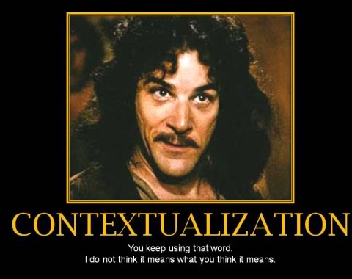
Inconceivable!
Notes:
Talk about the gaps of what they thought and where we really were- where is your perimeter now?
<number>

Slide 12
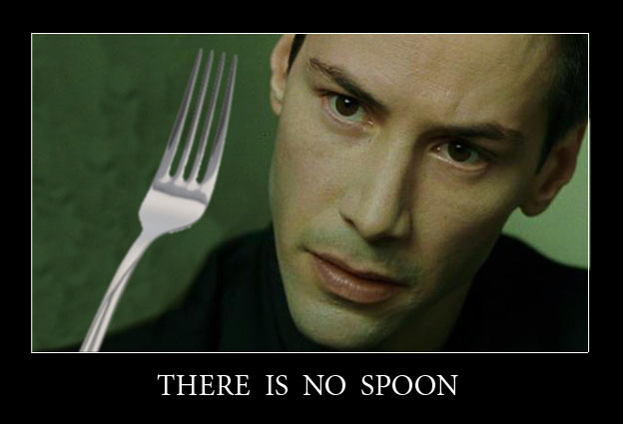
But Kevin….there is no spoon

Slide 13
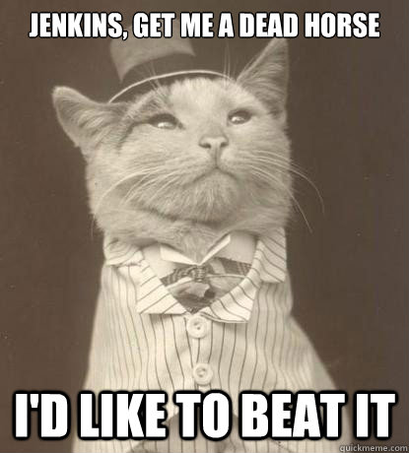
So yeah, moving along
Notes:
Enough background, let’s start talking about the solution
<number>

Slide 14


Dark clouds on the horizon…
Notes:
Kevin & Chris Risk and opportunity – A major business transformation project which will our future. Make one list of risks and one list of opportunities
Impact pops up – major game-changing update to critical business process, speak to current threat environment (target, sony, et. al.)
<number>

Slide 15
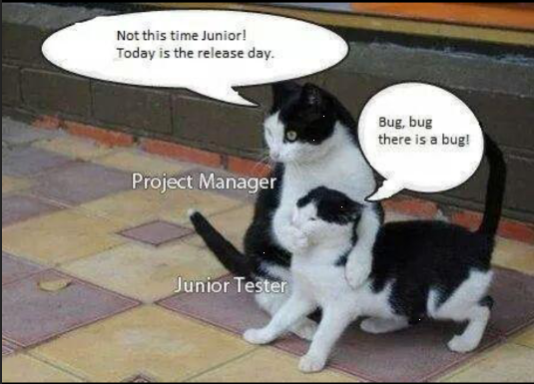
The 1st step of fixing a problem is recognizing you have a problem
Notes:
Setting a production date. Everyones perf mgt was hung on IMPACT
<number>

Slide 16

One direction?
Notes:
Kevin….Begin the conversation about changing the security architecture philosophy to encompass layered internal controls, less trust of the internal network, stop the bleeding,
<number>

Slide 17
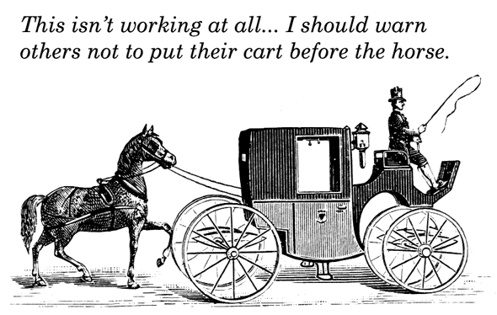
So…yeah….Carts & Horses and Stuff… I got it

Slide 18

Building and Finding the right people
Notes:
Kevin……Quit your job and get a career….Professionalize the team, put high value on personal transformation, customer service, make the right hires, In the 1st year I lost 2 people
We focused on building skill sets,
<number>

Slide 19
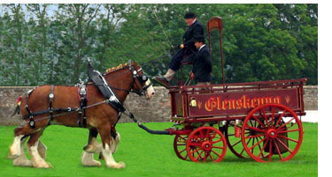
Adjusting the Process
Notes:
Chris – ken started the secarch framework; lots to do, many “unique processes” to modernize; stop sec from being a project-oriented thing and move it into an architectural-focused thing
<number>

Slide 20
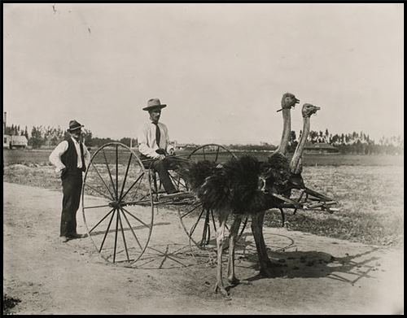
Picking the proper tools
Notes:
Chris steps in here…….Speak to value we see out of standards-based, enterprise-focused tools. This was also a huge shift for WF. Speak to the value of “XSA” and how that becomes the cornerstone of the new program. New Vulnerability platform, new IDS/IPS
<number>

Slide 21
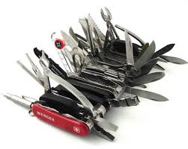


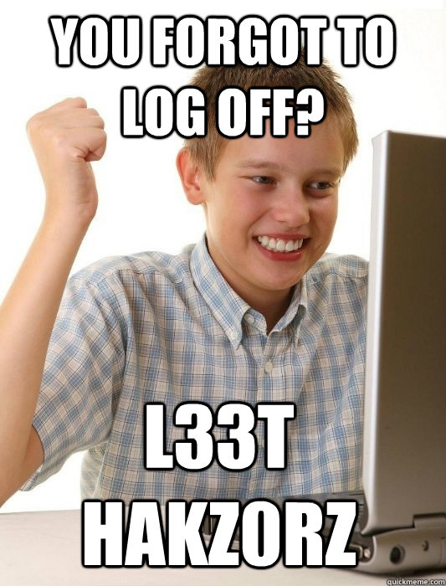
A word about my favourite IBM tools….

Slide 22
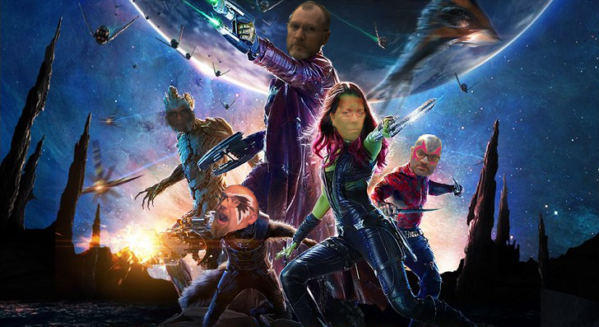
The value of a good partner
Notes:
Kevin tee up for Chris….ESAB.. Kb exec/mgr-path, crr grass-roots technical buy-in
<number>

Slide 23
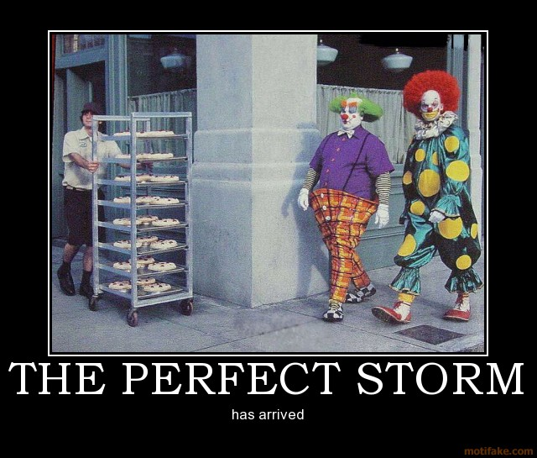
I love it when a plan comes together….
Notes:
Kevin …. Pass to Chris on Workshop mention…..Coordination/sync of state of infosys, secarch roadmap, ibm maturity workshop, full scope pen tests
<number>

Slide 24
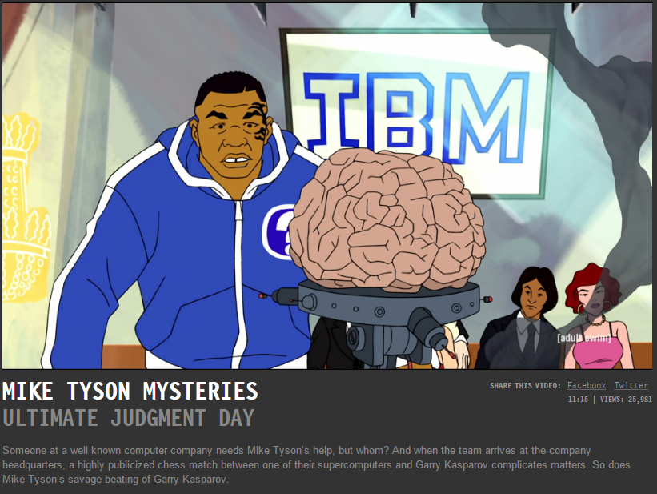
(stub for ibm maturity workshop...don’t forget to add cool stuff)
Notes:
Chris…..I can’t see here in the dark, so I must rely upon my other senses….like my sense of humour.
<number>

Slide 25
IBM Enterprise Security Maturity Workshop
This high-level workshop will assess the security posture of 35 controls across five domains: Security Analytics and GRC, People, Data, Application, Infrastructure.
IBM recognizes that all organizations are somewhere on a security continuum ranging from “basic” to “optimized”. The ESMW utilizes IBM methods, tools and intellectual capital to assess enterprises in the context of a Security Capability Model.
Security Intelligence
Automated
Optimized
Optimized Organizations use predictive and automated security analytics to drive toward security intelligence
Proficient
Proficient
Basic Organizations
employ perimeter protection, which regulates access and feeds manual reporting
Basic
Manual
Proficient Security is layered into the IT fabric and business operations
Reactive
Proactive
Notes:
Chris…maybe Ryan
<number>

Slide 26
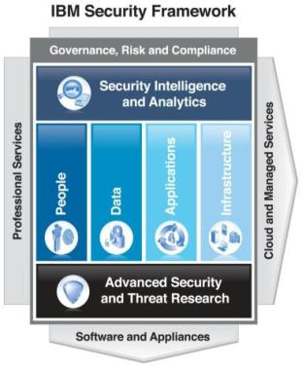
Enterprise IT Security Maturity Workshop (ESMW) “at a glance”
The IBM ESMW helps clients determine their “security maturity”:
1 day workshop addresses end-to-end Enterprise Security at a high level
Offered only to selected Global 2000 and similar sized Public Sector clients
Analysis and results are Client and IBM Confidential
Clients objectives and priorities identified from the post workshop roadmap will be shared with the appropriate IBM teams for follow up and action
Client benefits:
Improved visibility into the Enterprise “as-is” and “to-be” security postures
Fosters broad organizational buy-in for security priorities
Client can compare themselves to anonymous results from 20+ enterprises who have participated in the IBM ESMW over the past 18 months
Deliverables serve as excellent communication tools for budget priorities
*The ESWM does not replace IBM's more extensive and billable assessment services. Those billable offerings should be considered if you need a broader or deeper analysis than ESMW provides.
Notes:
<number>

Slide 27
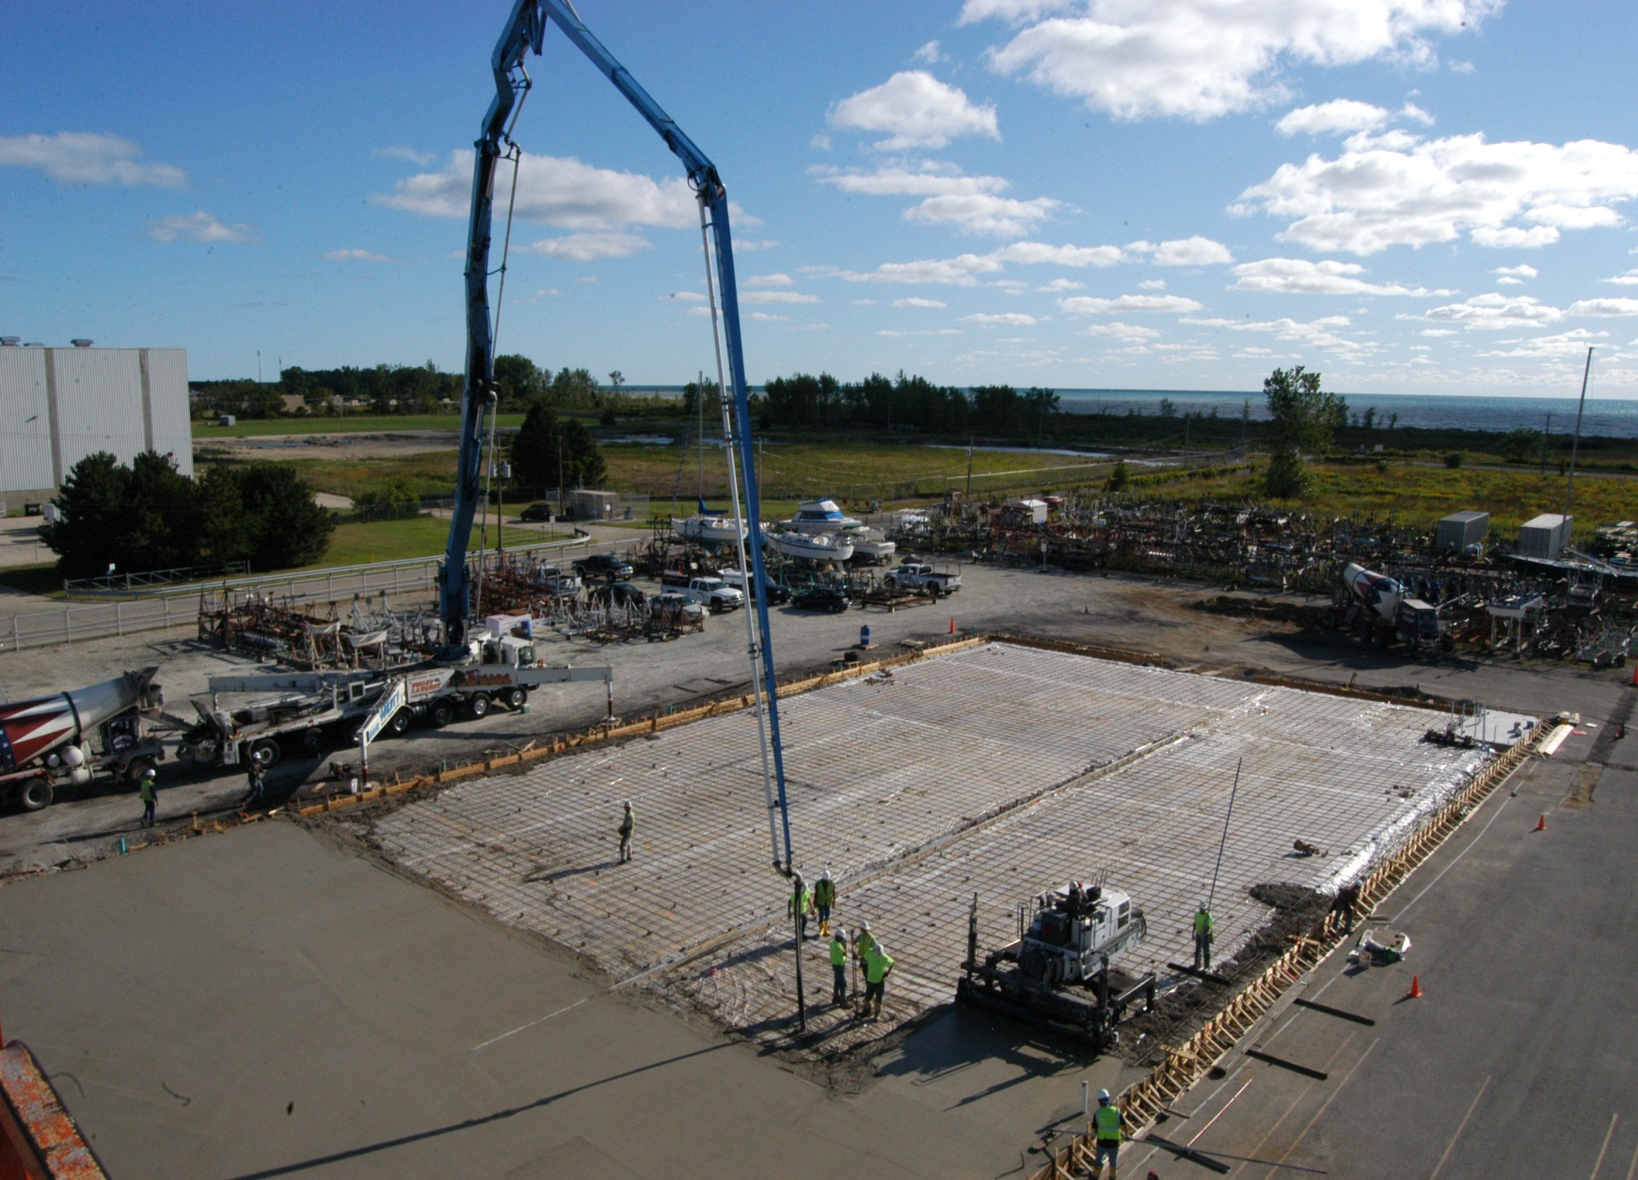
Laying the new foundation
Notes:
Kevin Formation of the ISOC at Bank & Group, ESAB – across the dev and ops org, …team
<number>

Slide 28








Where we sit today
Notes:
Kevin & Chris……Not only have we made major contributions to the larger enterprise, but we’ve also been able to give back to the larger communities…..Certs now, education/volunteerism, coops, training & awareness
<number>

Slide 29
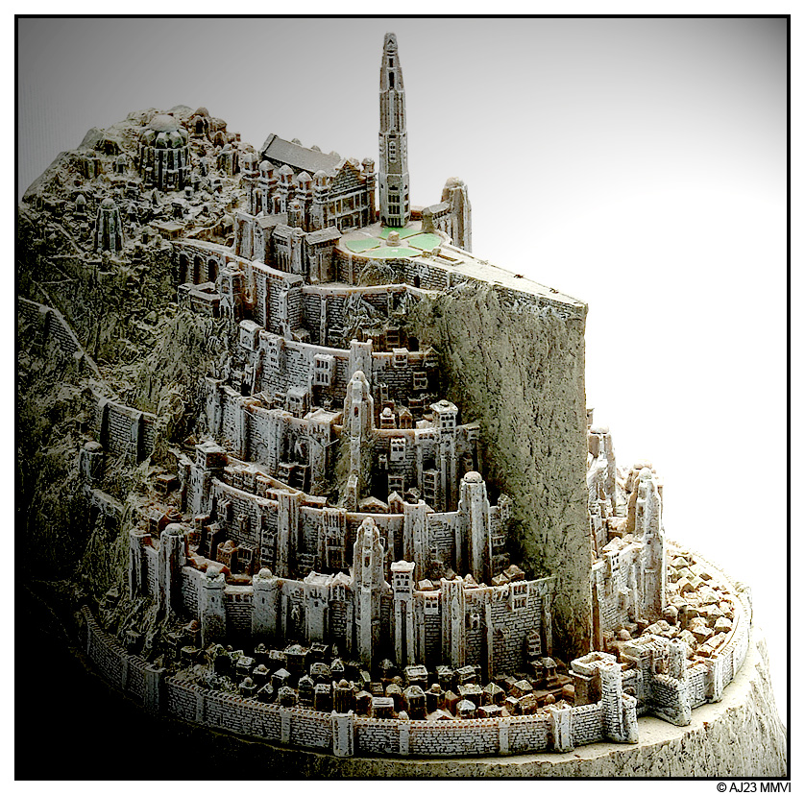
Shift in philosophy
Notes:
Chris
<number>

Slide 30
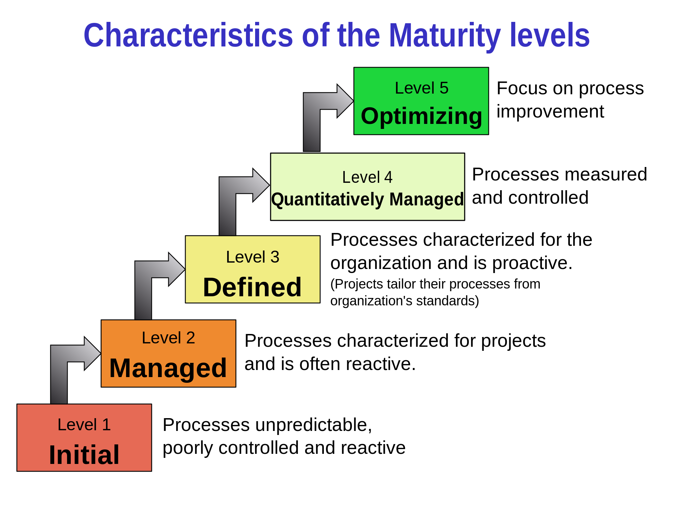
...To provide some perspective
Notes:
Chris
<number>

Slide 31
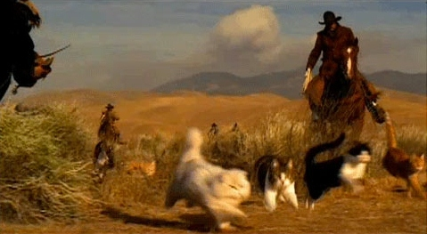
In closure….[don’t forget to add a big close]
Notes:
CRob – herding cats
<number>

Slide 32


Questions
Notes:
Kevin----Have we had some close calls? YES Do we think we have fixed everything? No The rate of uncovering the brokenness is greater? Do we feel confident? YES Is that warranted?
<number>

